Slide 1
Templating Shuffles
Qizhen Zhang, Jiacheng Wu, Ang Chen, Vincent Liu, Boon Thau Loo
^{Published at CIDR 2023}

Slide 2
Structure of Large-scale Analytics
Compute
  Distributed workers independently process local shards of data
Combine (optional)
  Preliminary results are locally processed before data exchange
Shuffle
  Resharding and transmitting data for the next phase of processing
Compute
Compute
Compute
Combine
Combine
Combine
Shuffle
Compute
Compute

Slide 3
Shuffle as Critical Component
Encompasses CPU, bandwidth, and latency overhead
  Compression, serialization, message processing, transmission, etc.
A rich history of tuning shuffle for efficient data analytics
  DBMSs, MapReduce, and graph processing
A primary bottleneck in cloud environments
  Serverless and disaggregated memory/storage
Shuffle

Slide 4
Challenges in Optimizing Shuffle
Dependent on workloads
  Disk activities, combinable, aggregable, data redundancy, etc.
Dependent on data center architecture
  CPU performance, network bandwidth, communication locality across machines, in-network acceleration, etc.
Must adapt to changes
  Data center topology updates caused by network failures
  Disaggregated compute, memory, and storage
  Next-generation data center network designs, e.g., random topologies

Slide 5
TeShu: Templated Shuffle Service
Enabling general, adaptive, and easily adopted shuffle optimizations in cloud data centers
Data system
…
Data system
Parameters
Parameters
TeShu
Parameterized templates
Data center infrastructure

Slide 6
Outline
Motivation
TeShu Design
Expressiveness
Evaluation
Future Directions

Slide 7
Architecture
Applications invoke shuffle API and instantiate templates to plans
Shuffle Manager stores and serves templates
A plan can sample messages to measure the efficiency of a particular shuffle strategy for adaptiveness

Slide 8
Shuffle Templates
Python-like programs with parameters below
Example: vanilla shuffling (pull mode)
Parameter | Description
SEND(dst, msg) | Send msg to dst
RECV(src) | Return data received from src
FETCH(src) | Return data fetched from src
PART(msgs, srcs, partFunc) | Partition msgs into dsts according to partFunc
COMB(msgs, combFunc) | Combine msgs according to combFunc
SAMP(msgs, rate, partFunc) | Sample msgs based on rate and partFunc
Basic communication (supporting both pull and push)
Populated by framework-native communication libraries
Partitioning, combining, and sampling
Populated by shuffle API arguments and our sampling approach
Sender template:
PART(bufs, dsts, partFunc)
Receiver template:
for s in srcs:
bufs[n] = FETCH(n)

Slide 9
Shuffle API
Shuffles are instances of concurrent communication between a fixed set of sources and destinations
shuffle(wId, templateId, shuffleId, srcs, dsts, bufs, partFunc, combFunc)
Partition function maps a shuffle item to a destination worker
Combine function merges two items into one
These arguments are used to populate template parameters
IDs of worker, template, and shuffle call
Sources, destinations, and data buffers
Functions for data partitioning and combining (optional)

Slide 10
Shuffle Management
System operators implement shuffle templates stored in Shuffle Manager
Application invokes shuffle API, instantiates templates into plans, and caches them
Operators/users
Shuffle Manager
Application
E.g., QO prefers a new template
Templates
shuffle()
implement
request
Template
cache
Issued shuffles
instantiate & execute
Template and plan cache
Records for monitoring and fault tolerance
cache
Completed shuffles
Plan

Slide 11
Outline
Motivation
TeShu Design
Expressiveness
Evaluation
Future Directions

Slide 12
Implementing Existing Shuffle Algorithms
Vanilla shuffling and existing shuffle optimizations can be expressed as templates in a few lines of code
Shuffle algorithm | Pattern | LoC
Vanilla shuffling | Push/pull | 5
Coordinated shuffling [CIDR ’13] | Pull | 9
Bruck shuffling [IJHPCA ‘05] | Push | 11
Two-level exchange [SIGMOD ‘20] | Push | 18

Slide 13
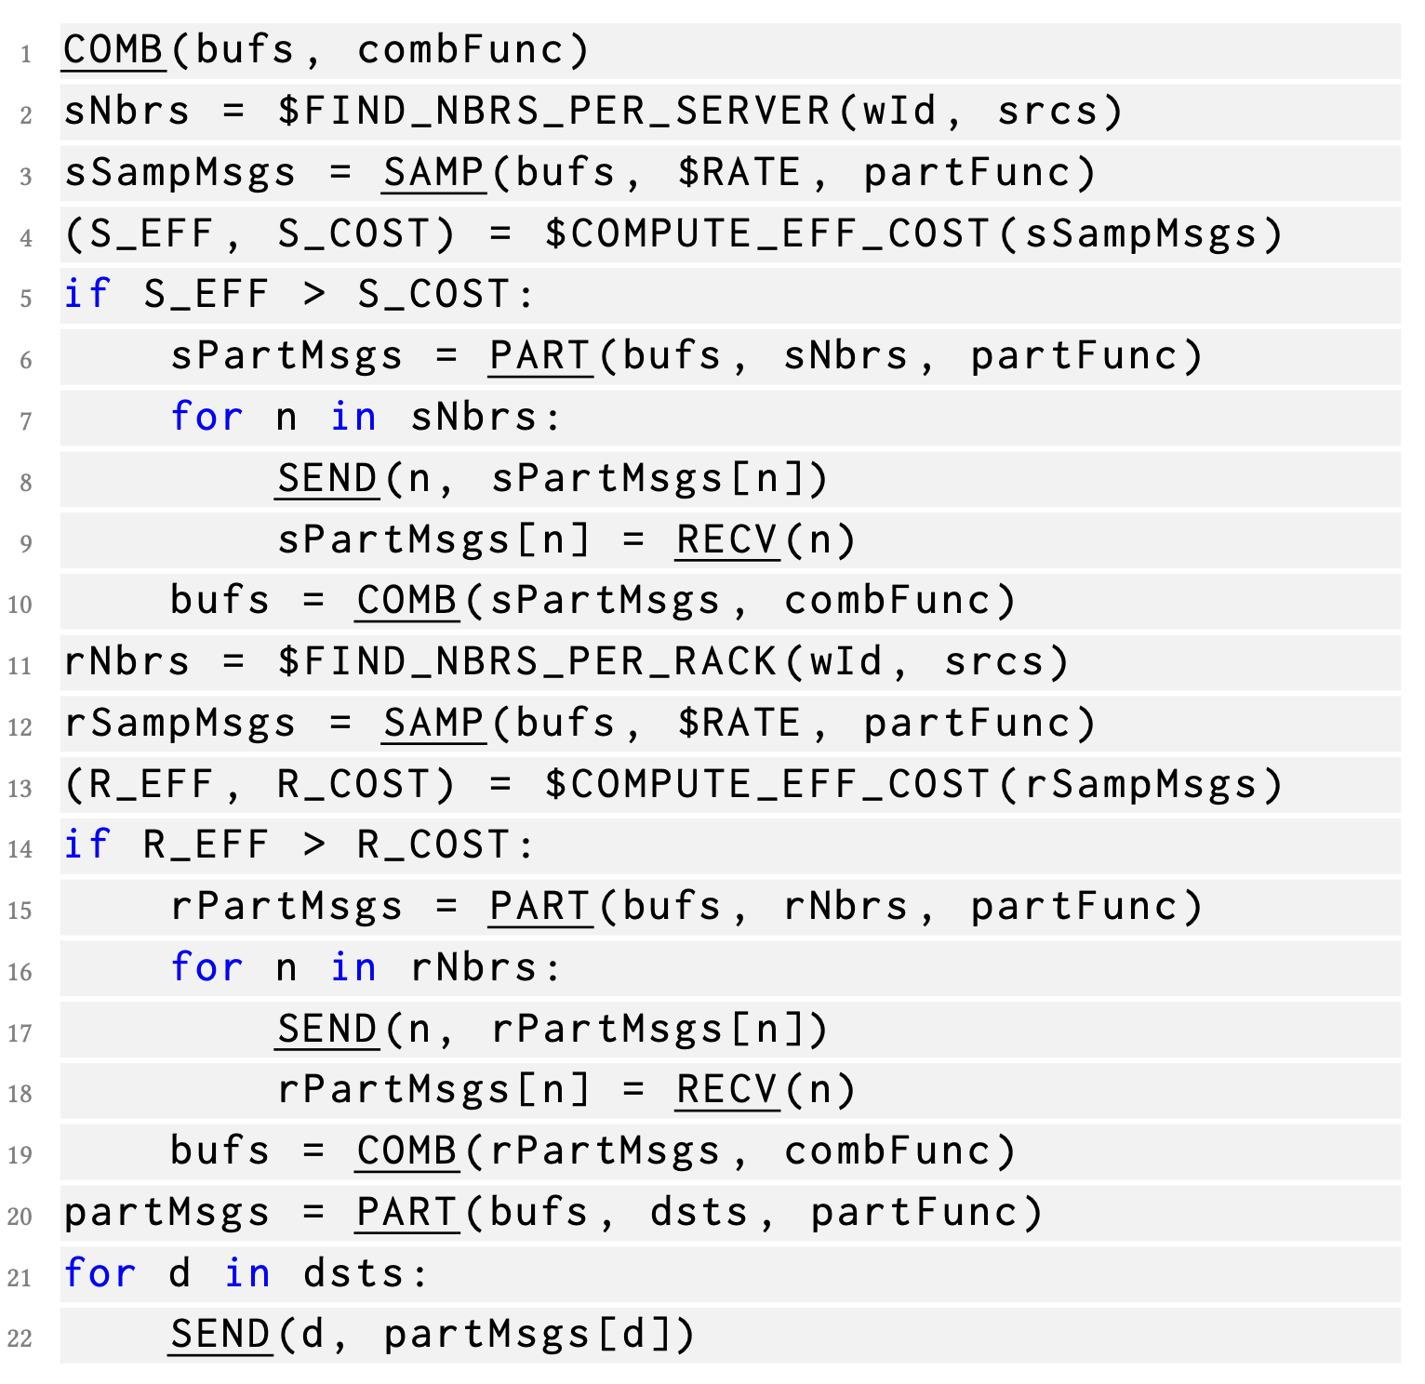
Adaptive Shuffling
Sampling-based shuffle optimization for data center networks
Global level
Cluster level
Rack level
Server level
｝
A local shuffle at each level
Pros: reduced traffic at next level by combining (benefit oversubscribed networks)
Cons: additional shuffling and combining overhead
Need to compare the benefit of traffic reduction and the overhead
Measured through data sampling

Slide 14
Data Sampling
Selects a subset of shuffle data based on sampling rate
Baseline: random sampling, which is inaccurate
Partition-aware sampling: samples data according to destinations to measure the effect of combining
  Divides destination space into S buckets based on sampling rate
  Assigns each shuffle item to one bucket based on its destination
  Samples Bucket j (j is arbitrary but consistent across workers)

Slide 15
Outline
Motivation
TeShu Design
Expressiveness
Evaluation
Future Directions

Slide 16
Evaluation Setup
Cluster: 2 racks of 10 servers, each with 16 cores @2.6GHz, 128 GB memory, and a 10 Gbps NIC
Network: cross-rack network is oversubscribed (10:1, 4:1, 1:1)
Software: Pregel+ for graph analytics
Queries: PageRank and single source shortest path
Datasets: UK-Web (3.7 B edges) and Friendster (3.6 B edges)

Slide 17
Sampling Performance
Duplication estimation on shuffled data with typical workloads
Sampling overhead (execution time)
Sampling rate | Ground truth | Part.-aware sampling | Random sampling
0.9 | 0.1833 | 0.1833 | 0.1986
0.1 | 0.1833 | 0.1833 | 0.7241
0.01 | 0.1833 | 0.1832 | 0.9622
0.001 | 0.1833 | 0.1829 | 0.9965
0.0001 | 0.1833 | 0.1838 | 0.9997
High accuracy even with low sampling rates
Low overhead, high accuracy

Slide 18
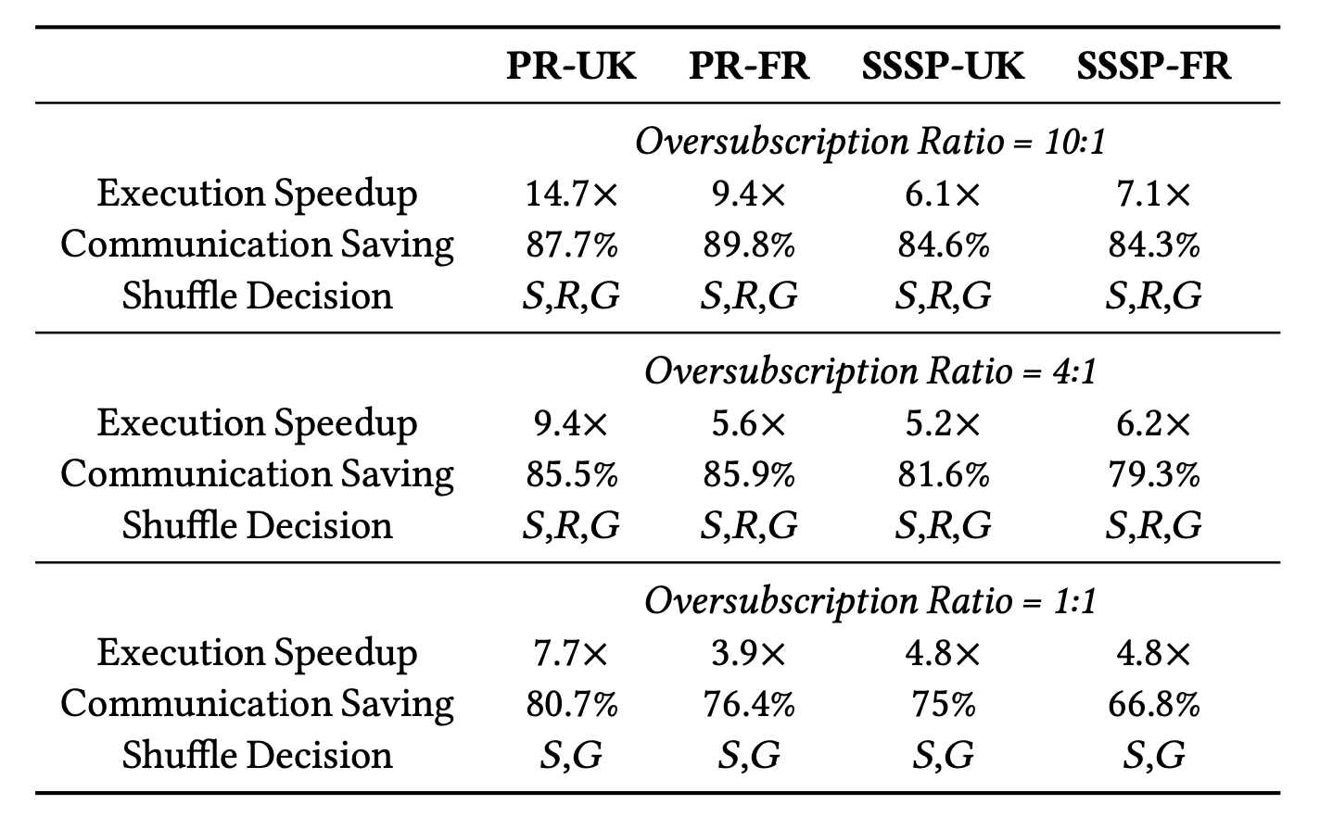

Adaptive Shuffling Performance
Compared to vanilla shuffling, adaptive shuffling enables 3.9$×$ to 14.7$×$ speedups by eliminating most of the communication
Across oversubscription scenarios, adaptive shuffling always identifies the optimal shuffling strategy

Slide 19
Outline
Motivation
TeShu Design
Expressiveness
Evaluation
Future Directions

Slide 20
Future Directions
Co-scheduling shuffles to achieve shorter flow completion times and thus improve application performance
Handling failures and stragglers with shuffle records
Integrating in-network techniques to apply combining and sampling in the network to further improve performance
Templating shuffles for future data centers, e.g., data movement between disaggregated resource components

Slide 21
Summary
Tuning shuffle for large-scale data analytics is necessary but challenging and requires adaptiveness
TeShu provides a simple yet expressive shuffle abstraction and offers a general layer for various data analytics systems
Shuffle templates and efficient sampling in TeShu enable portable and adaptive shuffle optimizations
More to be investigated and explored

Slide 22
The End

