Slide 1


ICASSP 2024 Speech Signal Improvement Challenge
Enhanced Samples by Participants
Nicolae-Catalin Ristea, Ando Saabas, Ross Cutler, Babak Naderi, Sebastian Braun, Solomiya Branets

Slide 2
2024 Blind set
The blind set contains 500 real-world samples at 48kHz with a wide range of distortions e.g., imbalanced bands, packet loss, bandwidth limitation, clipping etc.
The clips were captured from both PCs and mobile devices (similar with the last challenge).
A small percentage of clips were selected from the publicly available Common Voice data set.
The blind set language contains English, German, Dutch, French, and Spanish languages, with the majority of files (around 80%) in English.
There is an overlap between the 2023 and 2024 blind sets for progress evaluation.

Slide 3
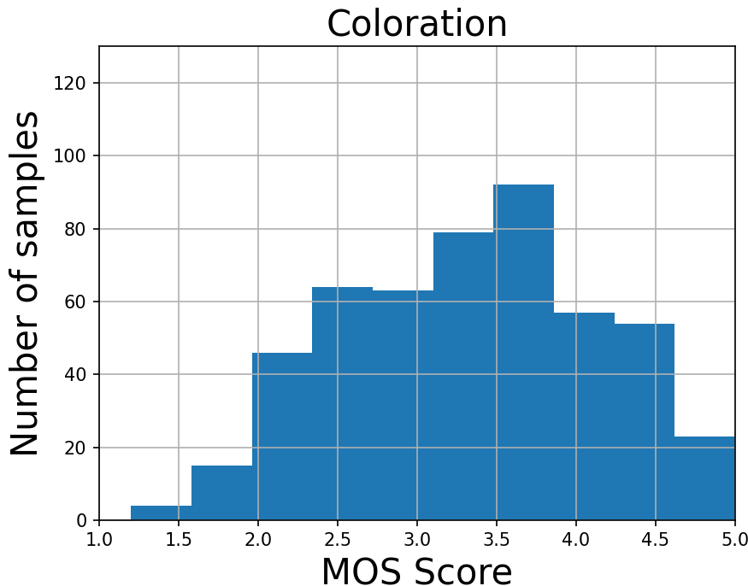
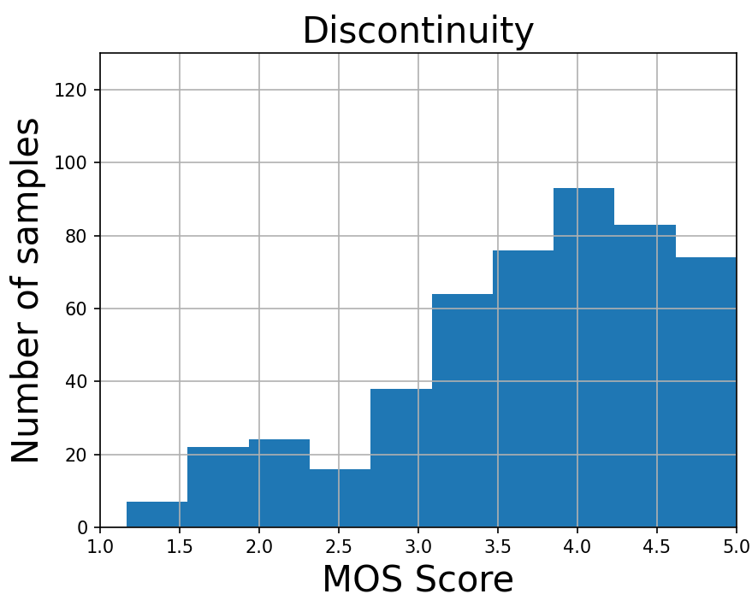
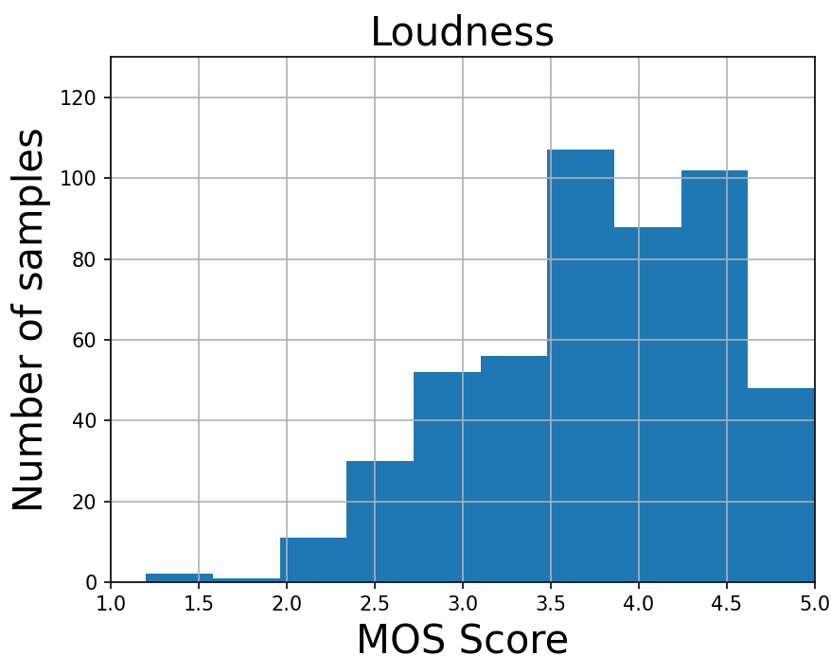
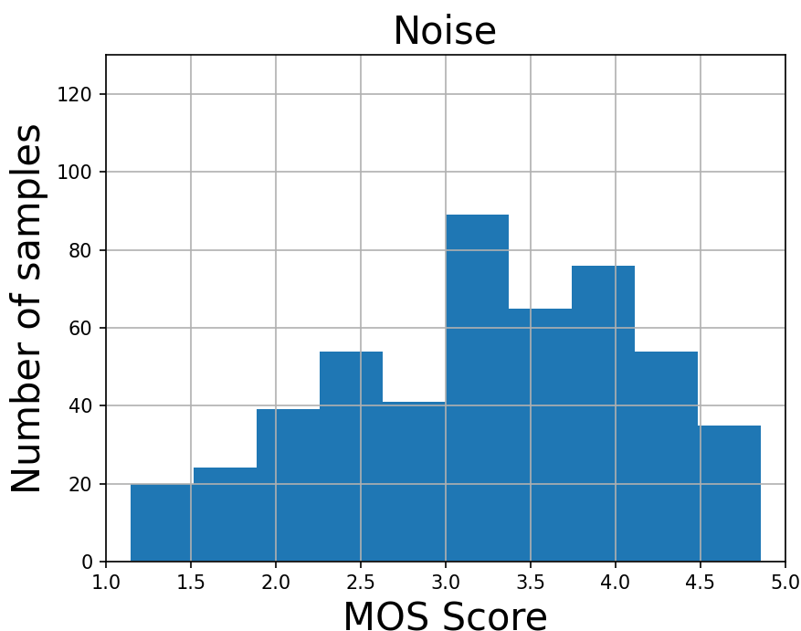
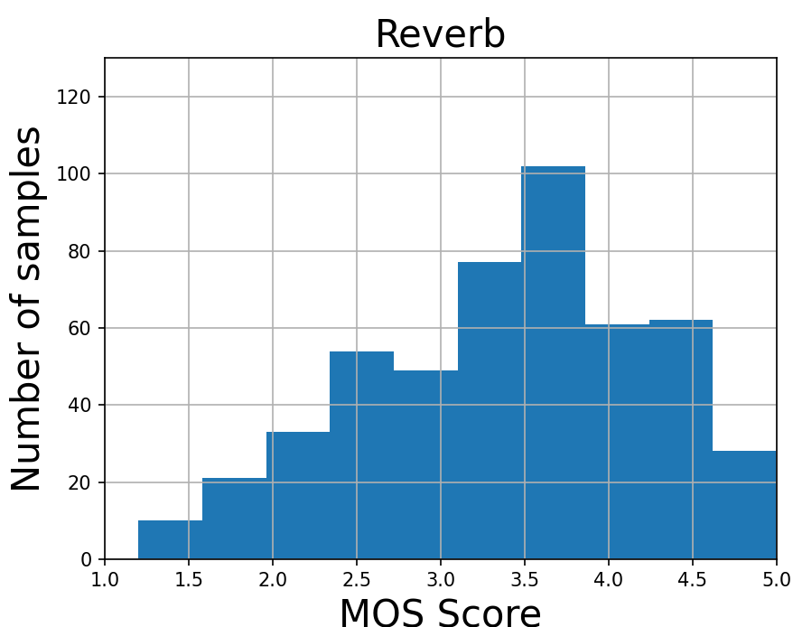
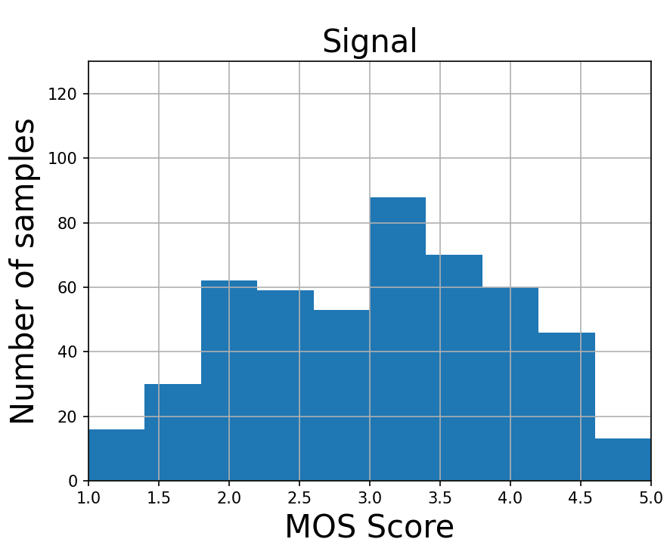
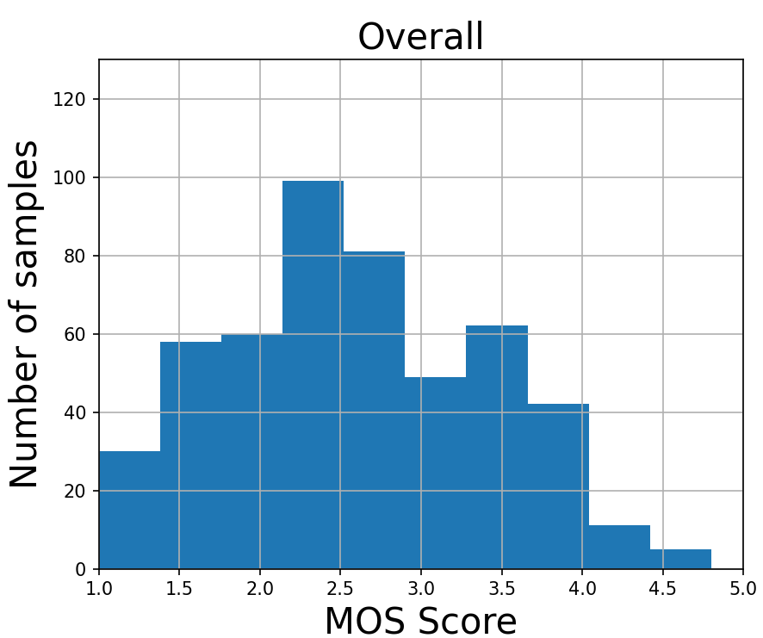
2024 Blind set P.804 subjective scores
P.804 details **B. Naderi, R. Cutler and N. -C. Ristea, "Multi-Dimensional Speech Quality Assessment in Crowdsourcing," ICASSP 2024

Slide 4

Main highlights
1024k
B&N
SpeechGroup-IoA
Nju-AALab
Sluice
Input signal:

Slide 5
Main opportunities
1024k
B&N
SpeechGroup-IoA
Nju-AALab
Sluice
Input signal:

