Slide 1



Tabular Representation, Noisy Operators, and Impacts on Table Structure Understanding Tasks in LLMs
Ananya Singha, José Cambronero, Sumit Gulwani,
Vu Le, Chris Parnin
PROSE

Slide 2

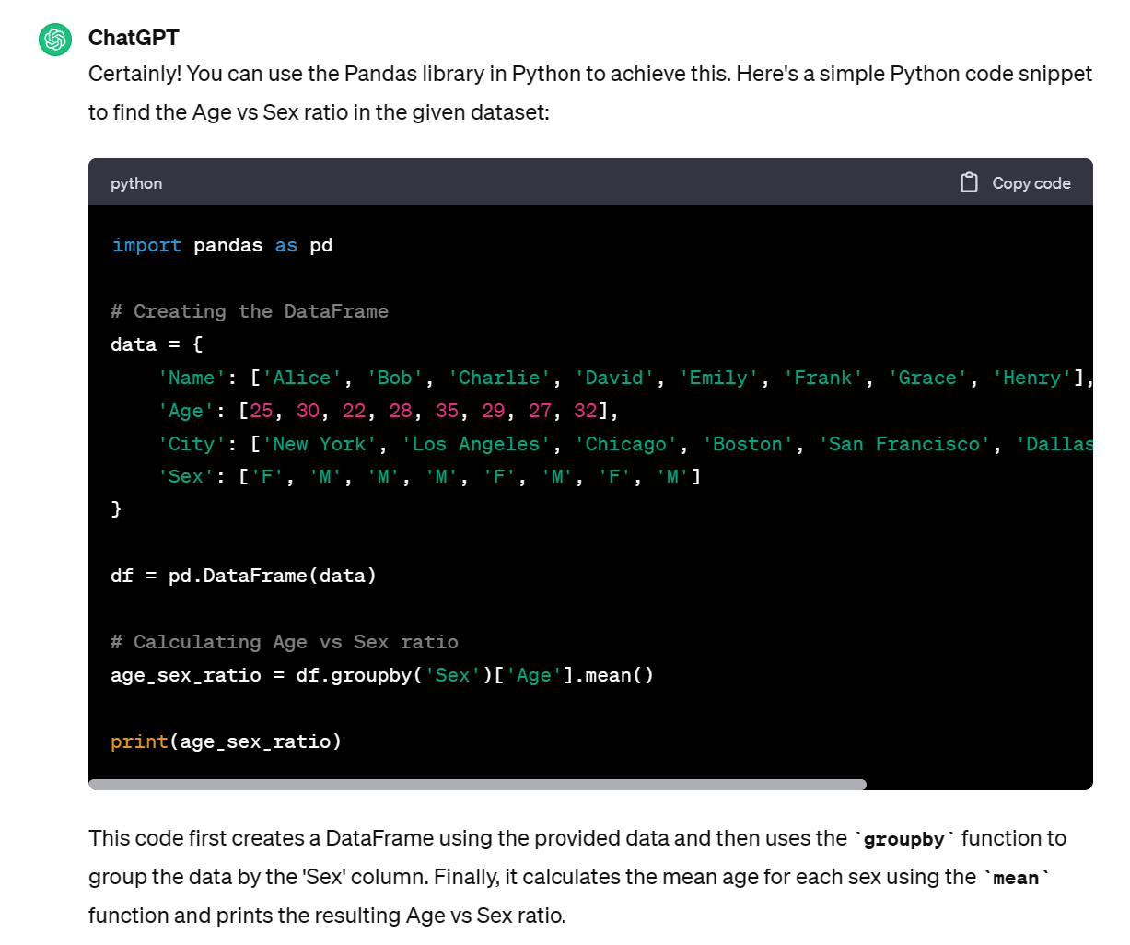
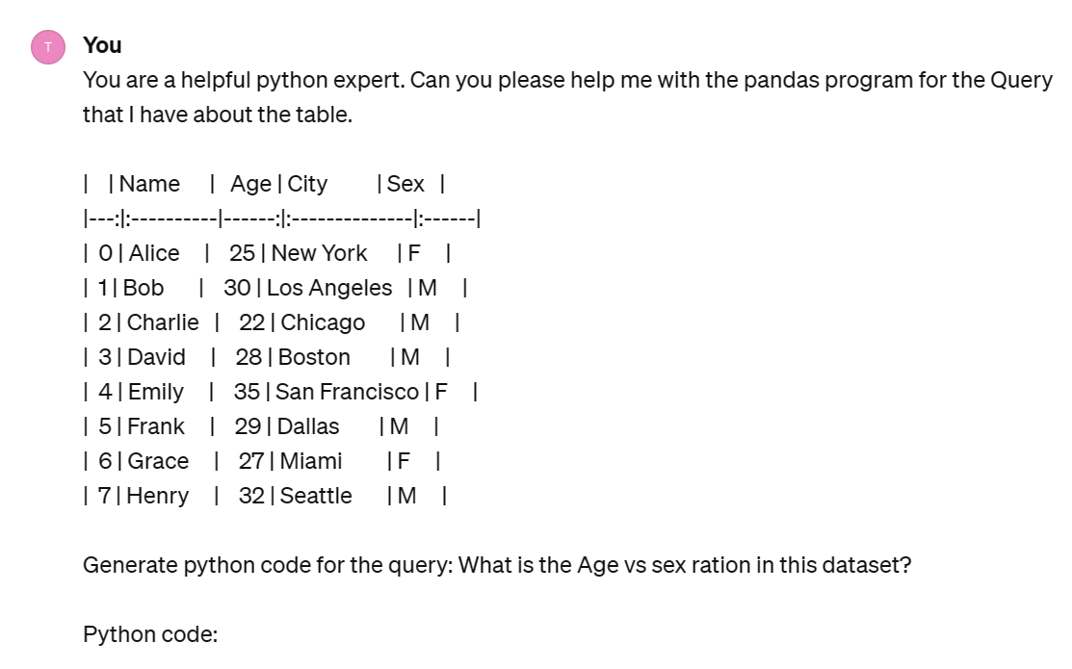
Motivation
In-Context Learning
Chat
GPT

Slide 3
Motivation
Is this the best way to represent the table?
In-Context Learning
Chat
GPT

Slide 4
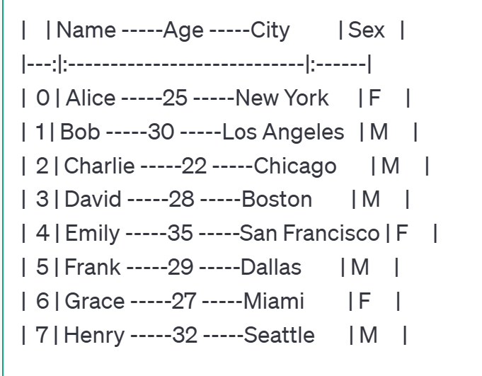
Motivation
Is this the best way to represent the table?
What is the impact of noisy data?
In-Context Learning
Chat
GPT
NOISE

Slide 5
Overview
We evaluate the LLM ability to answer the self supervised structural tasks over
    Eight Tabular Formats
    Eight Noise Operation
On Seven popular data-science datasets from Kaggle.

Slide 6


Approach
Table, T
Manipulated Table, T
(Task 1, Expected Answer 1)
Noise
Operator
Self-Supervised
Task
Generator
(Task 2, Expected Answer 2)
………………..…………..……
(Task n, Expected Answer n)
Table
Formatter
Prompt
Expected Answer 1
Answer 1
Metric:
pass@1/ F1 score
Expected Answer 2
Answer 2
LLM
………………
…………
Evaluation
Expected Answer n
Answer n

Slide 7
Tabular Formats
A range of eight popular table representation format used within data-science workflows.

Slide 8
DFLoader Format
Json Format
Data-Matrix Format
pd.DataFrame({
  Name : ['Alice', 'Bob', 'Charlie’],
  Age : [25, 30, 22],
  City : ['New York', 'Los Angeles', 'Chicago’]
  },
  index=[0, 1, 2])
{
"0": {"Name":"Alice","Age":25,"City":"NewYork"},
"1": {"Name":"Bob","Age":30,"City":"Los Angeles"},
"2":{"Name":"Charlie","Age":22,"City":"Chicago"}
}
[
['', 'Name', 'Age', 'City'],
[0, 'Alice', 25, 'New York’],
[1, 'Bob', 30, 'Los Angeles’],
[2, 'Charlie', 22, 'Chicago’]
]
HTML Format
Comma Separated Format
Tab Separated Format
<table>
<thead>
<tr>
<th></th>
<th>Name</th>
……..
<th>Sex</th>
</tr>
</thead>
<tbody>
<tr>
<th>0</th>
<td>Alice</td>
…….
<td>F</td>
</tr>
......
</tbody>
</table>
, Name, Age, City
0, Alice, 25, New York
1, Bob, 30, Los Angeles
2, Charlie, 22, Chicago
Name Age City
0 Alice 25 New York
1 Bob 30 Los Angeles
2 Charlie 22 Chicago
Markdown Format
HTML No Space Format
| | Name | Age | City |
|---:|:-----------|------:|:----------------|
| 0 | Alice | 25 | New York |
| 1 | Bob | 30 | Los Angeles |
| 2 | Charlie | 22 | Chicago |
<table><thead><tr><th></th><th>Name</th><th>Age</th><th>City</th><th>Sex</th></tr></thead><tbody><tr><th>0</th><td>Alice</td><td>25</td><td>New York</td><td>F<
/td></tr><tr><th>1</th><td>Bob</td><td>30</td><td>Los Angeles</td><td>M</td></tr><tr><th>2</th><td>Charlie</td><td>22</td><td>Chicago</td><td>M</td></tr></tbody></table>

Slide 9

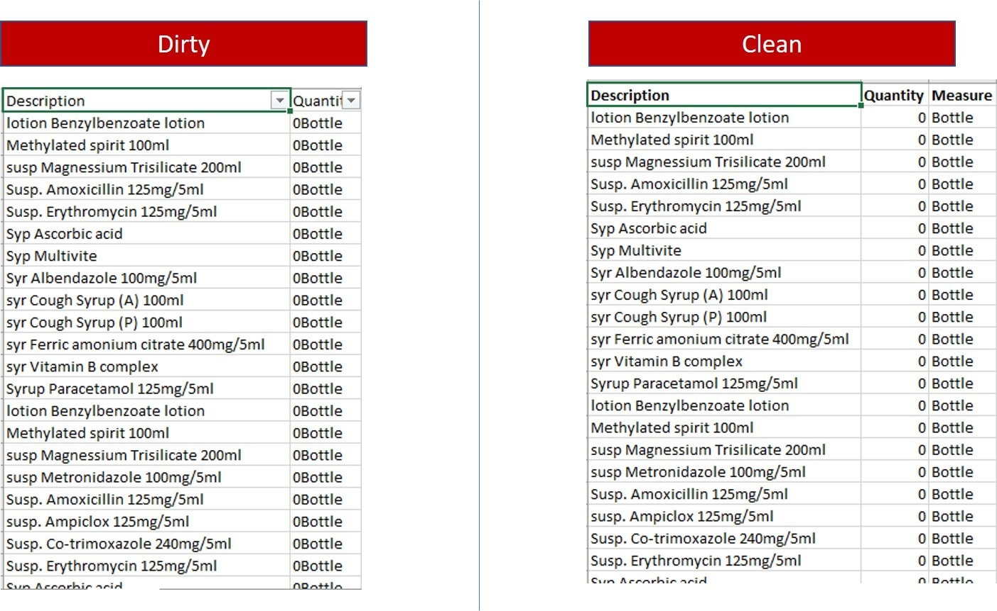
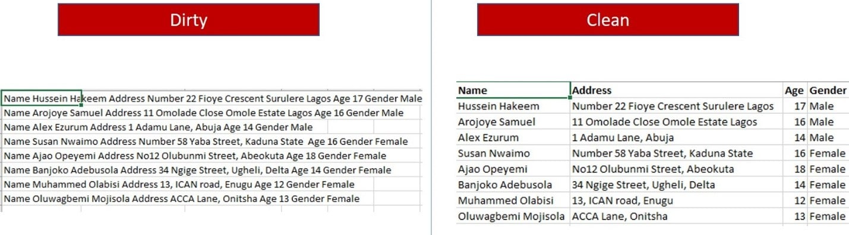
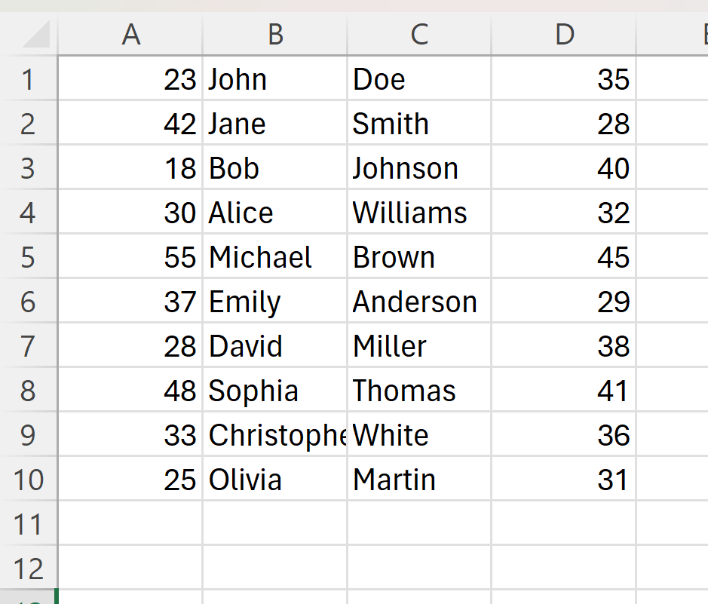
Noise Operation
SERIALIZED ROW
COMBINED COLUMNS
MISSING HEADER

Slide 10
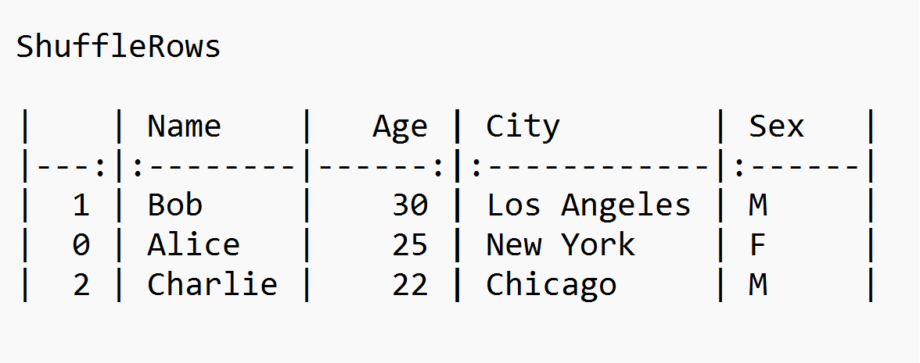
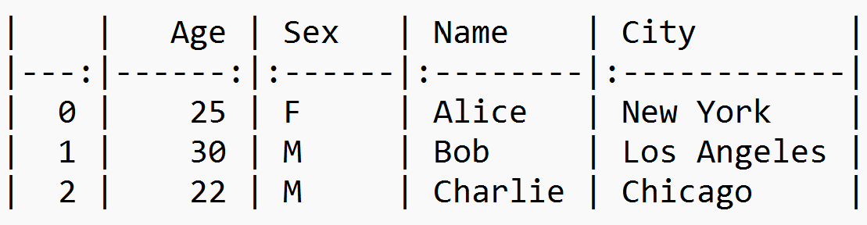
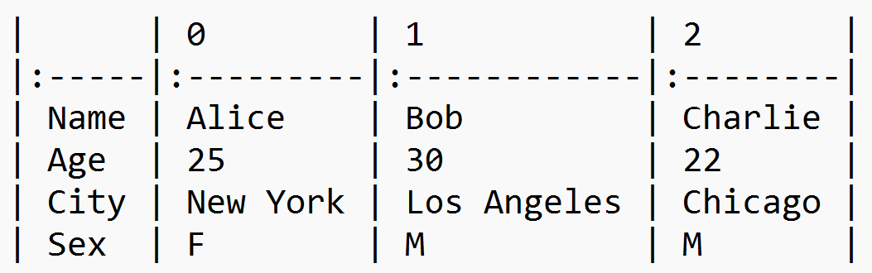
Spatial Invariance
ShuffleRows
ShuffleColumns
TransposeTable

Slide 11
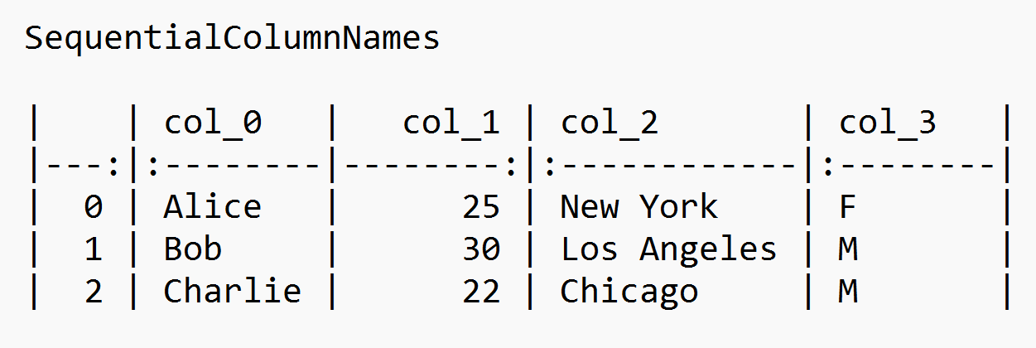
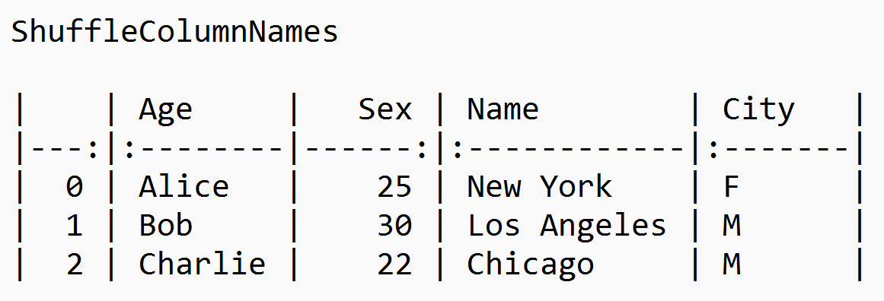
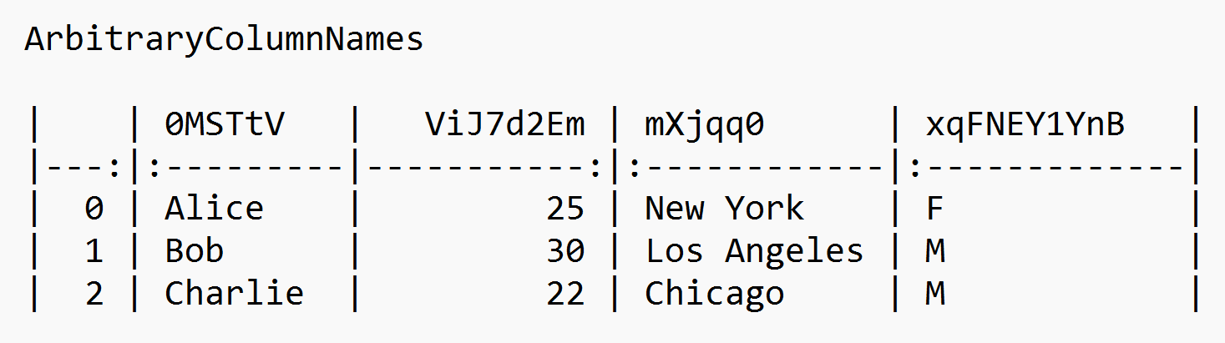
Header Manipulation
SequentialColumnNames
ShuffleColumnNames
ArbitraryColumnNames

Slide 12
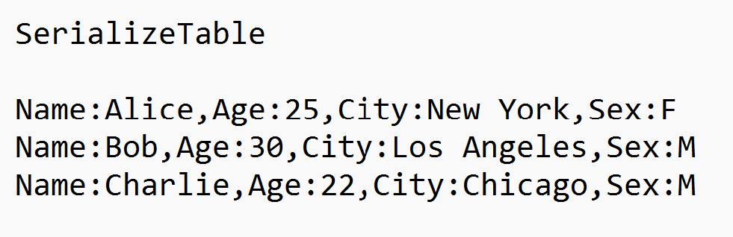
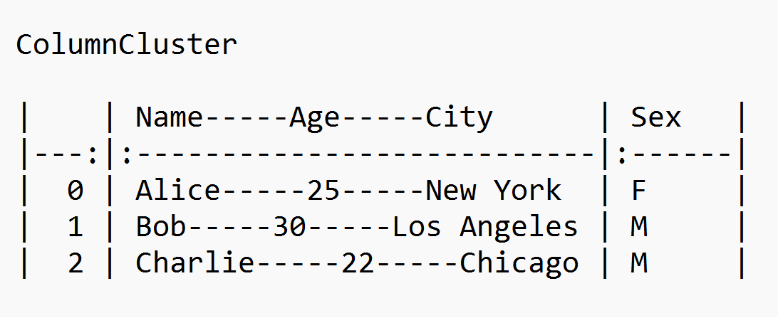
Semi-Structured Content
SerializeTable
ColumnMerger

Slide 13
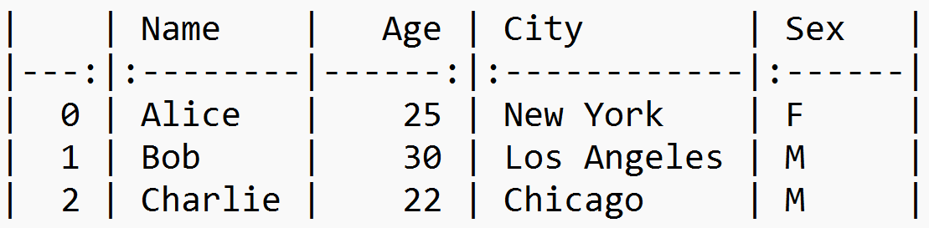
Self-Supervised Structural Tasks
Fact Finding Tasks
What type (using Pandas datatype notation) is column Age?
DataType Lookup Test
Table (T)
Column Lookup Test
What column is the value Charlie in?
Row Lookup Test
What row is the value New York in?
Navigation Test
What value is at row 1 and column City?

Slide 14
Self-Supervised Structural Tasks
Table Transformation Tasks
Table Transpose Test
Can you transpose the table?
Table (T)
Table Reconstruction Test
Can you reconstruct the table by deserializing the table above?
Table Column Reorder Test
Can you reorder the table such that the column are in this new order ['Sex', 'Name', 'Age', 'City']?

Slide 15
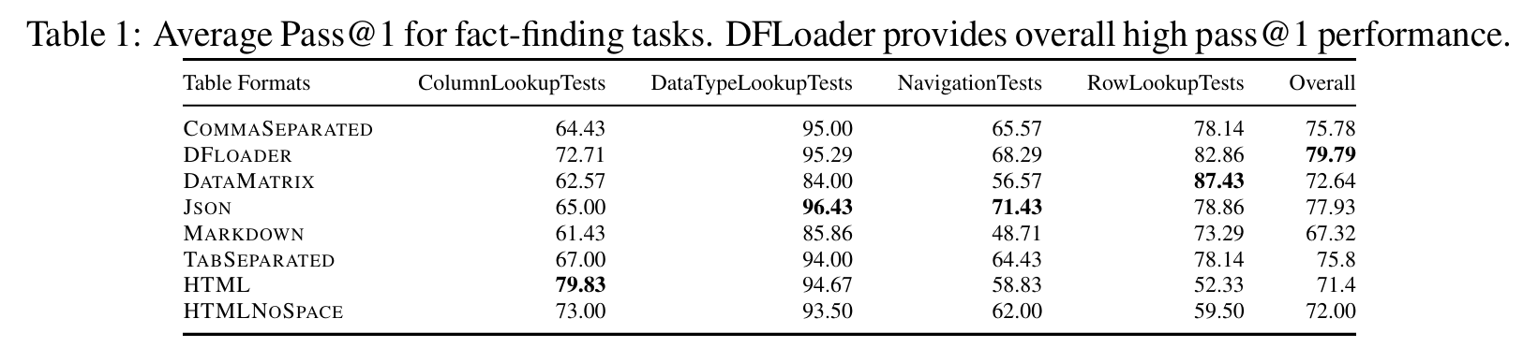
Results: Impact of Formats

Slide 16
Results: Impact of Formats
Markdown (-12.47%) < DF Loader

Slide 17
Results: Impact of Formats
Markdown (-12.47%) < DF Loader
NavigationTests
Column NavigationTests
Row 3

Slide 18
Results: Impact of Formats
Overall
Markdown (-12.47%) < DF Loader
Navigation Tests
Json (+5.86%) > CommaSeparated

Slide 19
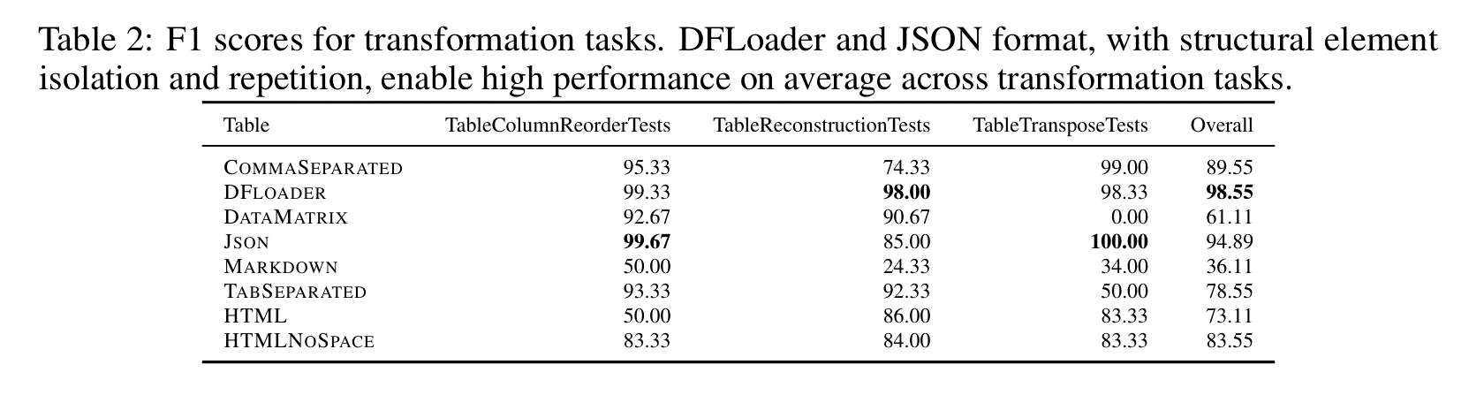
Results: Impact of Formats
Overall
Markdown (-12.47%) < DF Loader
Navigation Tests
Json (+5.86%) < CommaSeparated

Slide 20

Results: Impact of Formats
Overall
Markdown (-12.47%) < DF Loader
Navigation Tests
Json (+5.86%) > CommaSeparated
Overall
 | Fact-Finding Tasks | Table-Transformation Tasks
DF Loader | 79.79% | 98.55%

Slide 21
Results: Impact of Formats
Overall
Markdown (-12.47%) < DF Loader
Navigation Tests
Json (+5.86%) > CommaSeparated
Overall
 | Fact-Finding Tasks | Table-Transformation Tasks
DF Loader | 79.79% | 98.55%
Json | 77.93% | 94.89%

Slide 22
Results: Impact of Formats
Overall
Markdown (-12.47%) < DF Loader
Navigation Tests
Json (+5.86%) > CommaSeparated
Overall
 | Fact-Finding Tasks | Table-Transformation Tasks
DF Loader | 79.79% | 98.55%
Json | 77.93% | 94.89%

Slide 23
Result: Impact of Noise
NOISE
Json Format
Spatial Invariance: Transpose
Json Format
{
  “Name”: {“0”: Alice, “1”: Bob, “2”: Charlie}
  “Age”: { "0": 25, “1”: 30, “3”: 22},
  “City”: {“0”: NewYork”, “1”:Los Angeles”, “2”: “Chicago”}
}
{
"0": {"Name":"Alice","Age":25,"City":"NewYork"},
"1": {"Name":"Bob","Age":30,"City":"Los Angeles"},
"2":{"Name":"Charlie","Age":22,"City":"Chicago"}
}
Column/Row Lookup (-65%,-76.29%)< Original

Slide 24
Result: Impact of Noise
Transpose Noise | Json Format
Column/Row Lookup (-65%,-76.29%) < Original

Slide 25
Result: Impact of Noise
NOISE
Transpose Noise | Json Format
Row Serializer
SerializeTable
Column/Row Lookup (-65%,-76.29%) < Original
Original
DataType Lookup (-12.8%) < Original

Slide 26
Result: Impact of Noise
Transpose Noise | Json Format
Column/Row Lookup (-65%,-76.29%) < Original
Row Serialize Noise | Json Format
DataType Lookup (-12.8%) < Original

Slide 27
Result: Impact of Noise
NOISE
Transpose Noise | Json Format
Column Name Sequencer
Column/Row Lookup (-65%,-76.29%) < Original
Original
SequentialColumnNames
Transpose Noise | Json Format
Column/Row Lookup (-65%,-76.29%) < Original
Row Serialize Noise | Json Format
DataType Lookup (-12.8%) < Original
Column Reorder (-67.33%) < Original

Slide 28
Result: Impact of Noise
Transpose Noise | Json Format
Column/Row Lookup (-65%,-76.29%) < Original
Row Serialize Noise | Json Format
DataType Lookup (-12.8%) < Original
Column Name Sequencing Noise | Comma Separated Format
Column Reorder (-67.33%) < Original

Slide 29


Future Directions
Impact of Format and Noise's on End-to-end Tasks
Cross-LLM performance

Slide 30

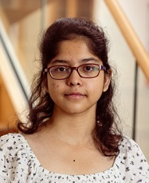
Reach Out For Questions
Ananya Singha
Microsoft
ananyasingha2000@gmail.com
[GitHub/LinkedIn/Twitter]
Full Paper: Tabular Representation, Noisy Operators, and Impacts on Table Structure Understanding Tasks in LLMs
Code: prose/misc/TRL-neurips-2023 at main · microsoft/prose (github.com)
PROSE
PROSE - Microsoft Research

